Slide 1
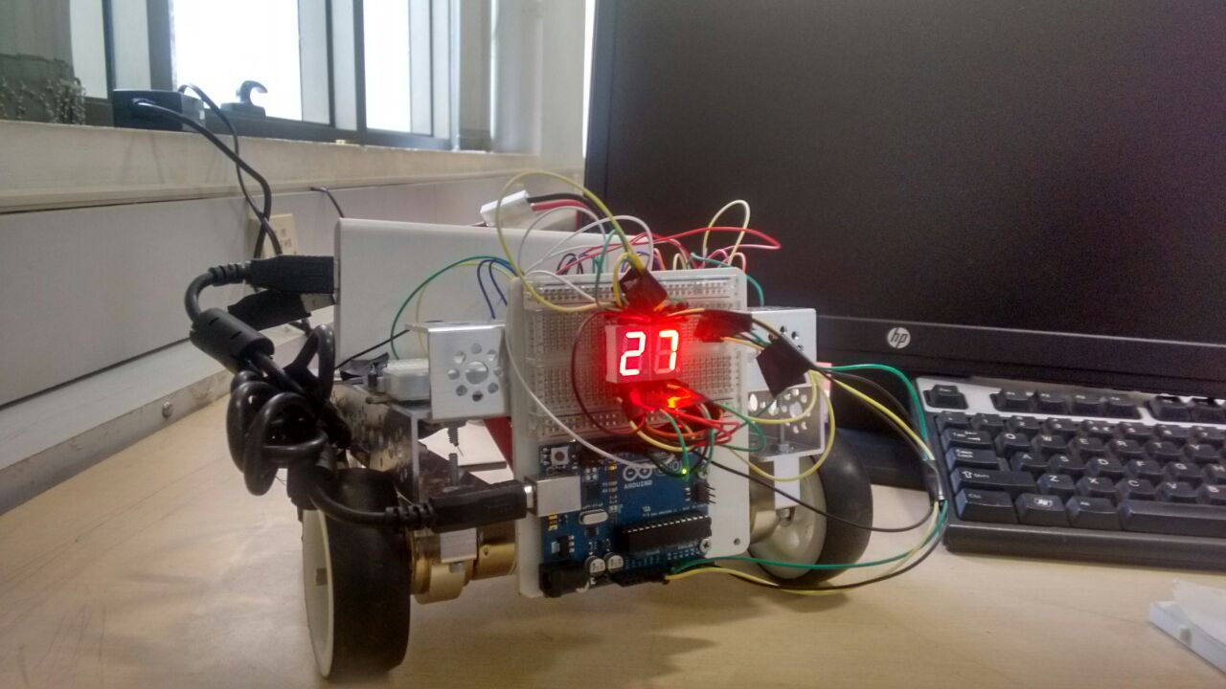
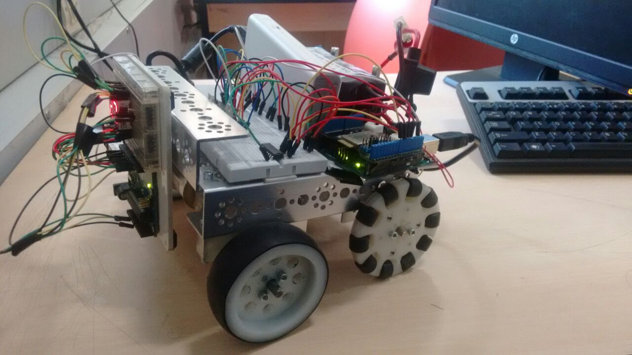
TEMP-AND-INO
SHASHANK,PRANEETH,CHAKRI
IIIT BANGALORE
INTRODUCTION
We built a car which works by the instructions given by the android phone .
This is temperature detecting android controlled arduino microcontroller
Conclusions and future work
The car which we built can be used for temperature sensing in different situations like checking the room temperature automatically and mainly for high security places(president house or places with extra care(infant care).We can integrate camera and make our work easier to record and can simuntaneously watch in our android mobile.
MATERIALS AND METHODS
We built a car using tetrix kit
We drived the motors using motor drivers lm293d
We connected to android mobile using bluetooth module
We built the app using mit app inventor
ACKNOWLEDGEMENTS
We would like to thank Madhav Rao Sir for this oppurtunity.
And also suport of Nirmal and Pratesh from ESD in bluetooth integration.
REFERNCES
Arduino library.
Arduino-bluetooth connection
Mit app inventor
Notes:
Copyright Colin Purrington (http://colinpurrington.com/tips/academic/posterdesign).

